Slide 1

Period End Closing Execution (BSC)
Period End Closing Key Process Areas and New Period End Checks
Posting Period Control
Intercompany and Period End Closing
Lease Accounting and Period End Closing
Cost Management Closing Activities
Period End Closing for Accruals and Recurring Entries
Period End Data Checks
Asset Accounting Closing Activities
VAT Clearing and Reporting
GR/IR Closing Activities
Material Ledger Closing (Non-GSC Activities)
Automatic Clearing of LSC¹⁾ Accounts
G/L Closing Activities for Financial Statement Preparation
¹⁾ LSC – Accounts with indicator “Clearing Specific to Ledger Groups” active.

Slide 2
Period End Closing Key Process Areas and New Period End Checks
Monthly Accrual Run
Period End Closing for Accruals and Recurring Entries
Monthly Recurring Entries Posting

Slide 3
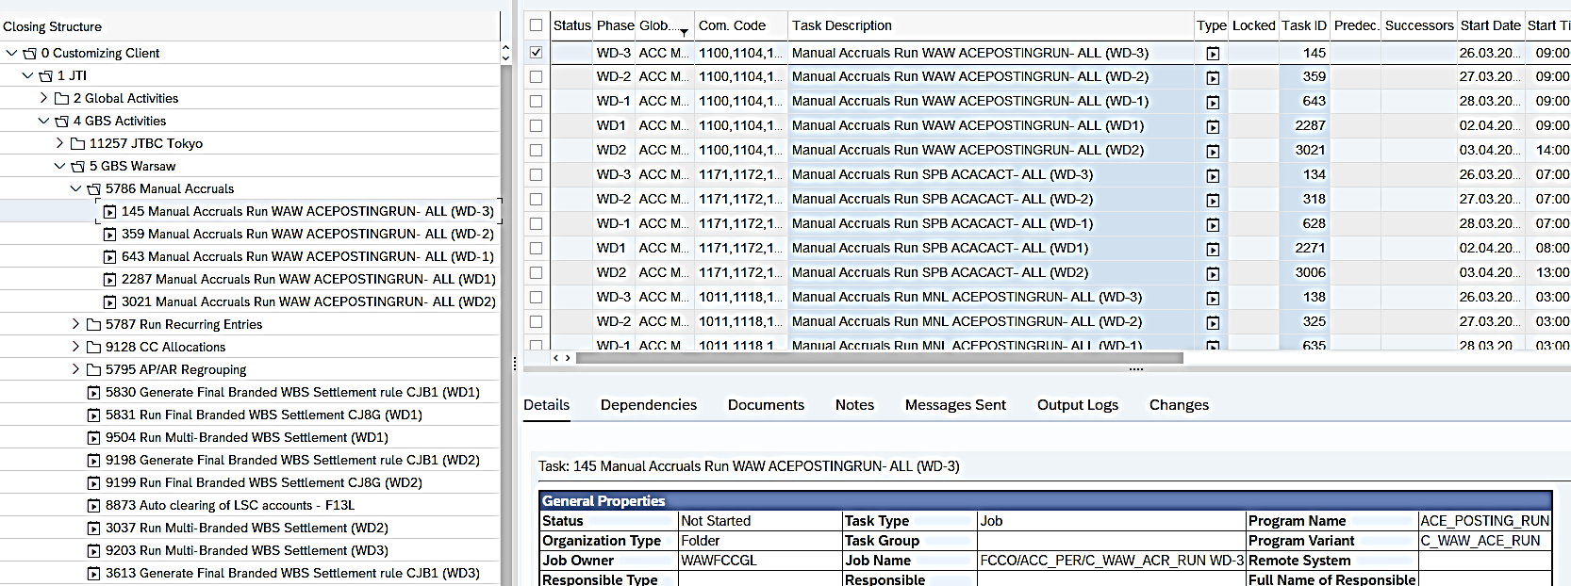
Monthly Accrual Run (1/6): Overview
Basic Accrual Engine Process
Create Accrual Object
Monthly Accrual Run
Accrual Engine Reporting
The following is entered in the Accrual Object during the month:
Information of the prepaid expense
Key parameters determining how prepaids are to be calculated and accounts to be used for postings
Inception posting is made upon creation
Monthly accruals posted via automatic accrual runs
Display using standard FAGLL03H G/L report and Fiori App
Display totals or line items
Deferred expenses by vendor
T-Code: ACEPOSTINGRUN
The Monthly Accrual Runs simply make postings for the amortization of the prepaids, using the G/L accounts determined by Accrual Type of each Accrual Object.
FCC Task: GBS Level
Entities using Accrual Engine are included in the GBS variants for ACEPOSTINGRUN. Like any task set at GBS level, you should ensure the respective variant has included the required entities before the tasks are due to be run.
Timing: WD-3 to WD2 daily
This is to ensure any newly created Accrual Objects can be captured for the monthly run.

Slide 4
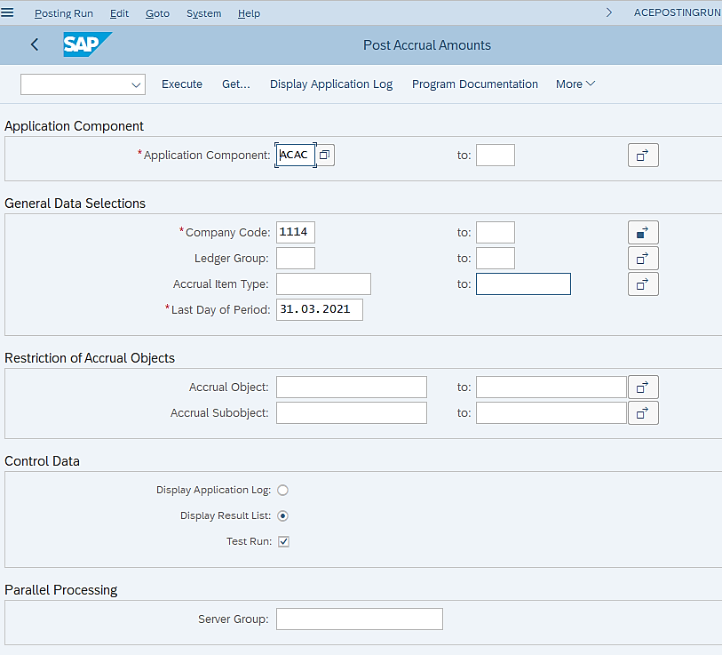
Monthly Accrual Run (2/6): Execution
Remember this is a “GBS variant” therefore Company Code field must be reviewed / amended when executed outside of FCC!
Application Component ACAC stands for Manual Accrual, which is the functionality that JTI uses for Accrual Engine process.
ACEPOSTINGRUN– Periodic Accrual Run
Each GBS is expected to execute this transaction for all the entities they are responsible for which use the Accrual Engine process. Therefore, make sure you check that all the required company codes have been included before execution – these should be included in your future FCC variants.
If you execute this transaction outside of FCC when only certain entities belonging to your GBS need to be included for the reason of either error correction or reacting to any emergency issue during period end closing, you should always check the list of Company Codes included here and make the necessary adjustments if needed.
We leave Ledger Group and Accrual Item Type selection blank, as accrual objects created in all Ledger Groups and with all Accrual Item Types should be included in the monthly posting.
Key date should be the balance sheet date of the period that you are closing.
Further restrictions to Accrual Objects should only be used if you are executing this transaction outside of FCC for specific correction purposes.
It is recommended that you select the Display Result List option so that the results of amortization of which Accrual Objects are successful are shown.
You must remove “Test Run” in your FCC variant, but you should do a Test Run if you execute the transaction outside of FCC, so that you can detect errors before an update run.

Slide 5
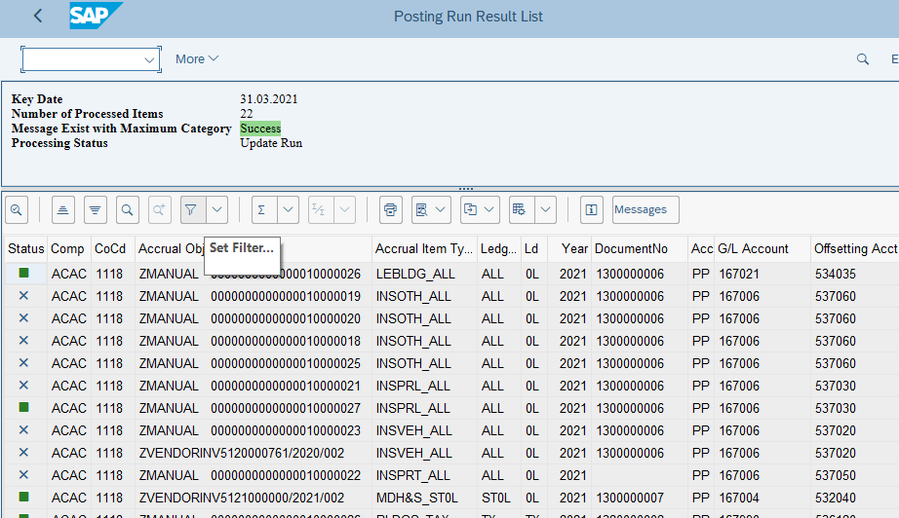
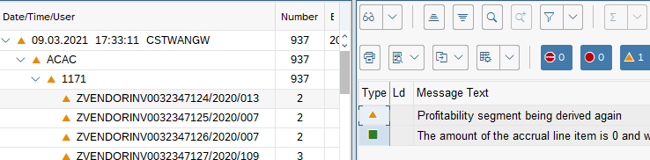
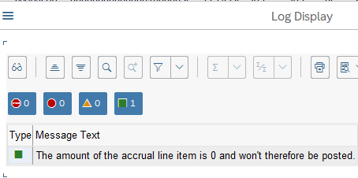
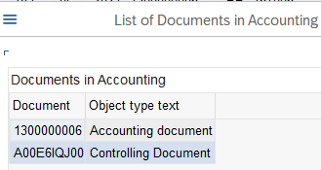
Monthly Accrual Run (3/6): Messages
ACEPOSTINGRUN– Periodic Accrual Run
Success
You will see Success Message if the ACEPOSTINGRUN run is successful.
Following a successful update run, you can then either double click the DocumentNo to display the document generated, or go to the reports such as FB03/FAGLL03/FAGLL03H to find your posted documents. You can use fields such as Document Type (SD), TCode (ACEPOSTINGRUN), etc. to locate your documents/line items.
Warning or Error
You may display all messages via this button. You should pay attention to only Warning or Errors listed here, if any.
No periodic posting
You will be able to click on these crosses to see why no posting has been made to certain Accrual Objects. These are not errors but simply no posting has been made.
The most common reason for no periodic posting, as demonstrated in testing environment is when there’s no value to amortize, or monthly posting for the selected period has been made already.

Slide 6
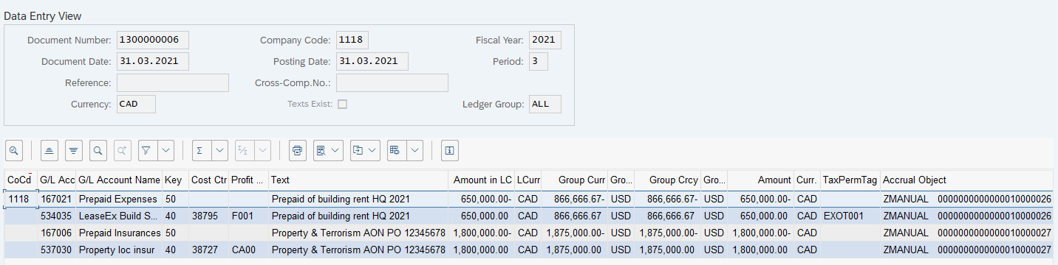
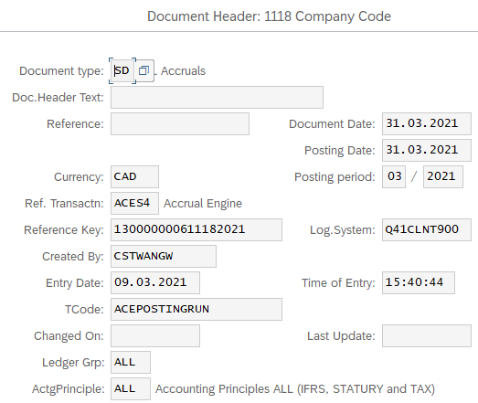
Monthly Accrual Run (4/6): Posted Documents
FB03 – Display FI Document
Posted Document from Monthly Accrual Run
The documents posted via the Monthly Accrual Run contain information based on the Accrual Object master data, the parameters used in the Monthly Accrual Run, as well as automatically generated information by the system.
In the recent SAP release of Accrual Engine, the parameters entered during ACEPOSTINGRUN are very limited, including only Company Code and Posting Date. This means, as you can see from our example, majority of the information from the posted monthly amortization document is derived from the Accrual Object master data.
Like any other postings made in the Accrual Engine process, the monthly amortization postings are also presented in the FI G/L line item reports, as well as the dedicated reports for Accrual Engine.
Legend
Automatically generated by the system
Determined by the Accrual Object master data
Determined by the Monthly Accrual Run execution parameter

Slide 7
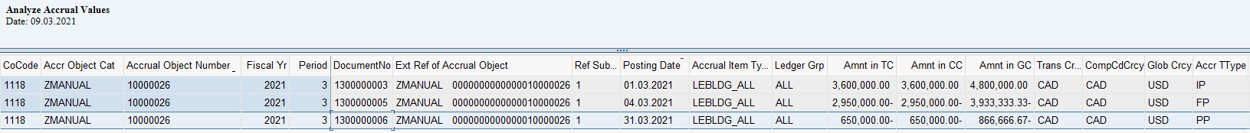
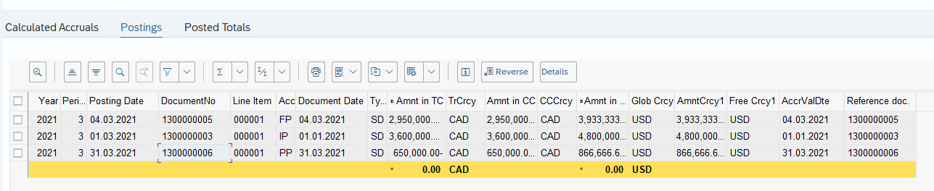
Monthly Accrual Run (5/6): Reporting
ZFFIA_ACC_TOTAL – Line Items
ZR2R_ACACTREE02_001 – Display Accrual Object (Postings tab)
In the Accrual Engine Line Item report, as well as G/L Line Item report (e.g. FAGLL03H) you can find the corresponding postings generated from Monthly Accrual Run.
You can also display the [Postings] tab of the Accrual Object to locate the Monthly Accrual Run postings.
The Accr TType (Accrual Management Transaction Type) is PP for Monthly Accrual Run posting, indicating this is a periodic recognition of expenses.

Slide 8

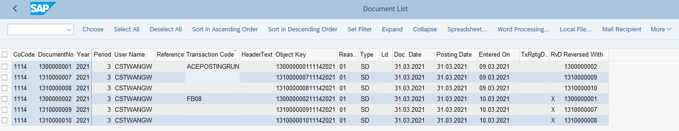
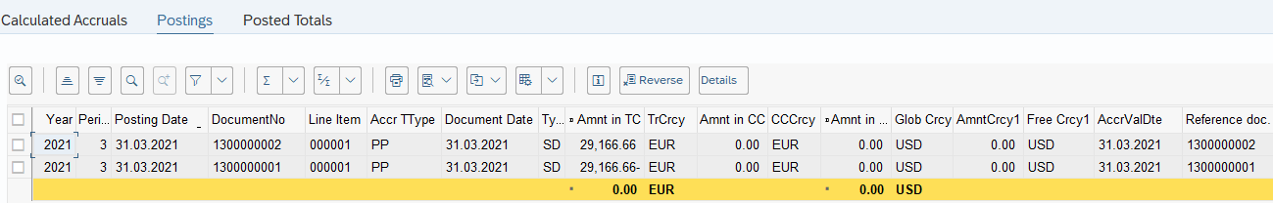
Monthly Accrual Run (6/6): Reversal
In the recent SAP release, line items posted via Monthly Accrual Run is treated as direct FI entry. In the very unlikely event when these line items need to be reversed, the standard FI document reversal T-codes FB08/F.80 can be used.
Entities should submit a MyRequest reversal request to have these postings reversed if the reason for reversal is originated on the entity side.
FB03 FI Document Display
Upon reversing a monthly accrual posting document, you will see its reversal document indicated in field [Reversed With], just like any other direct FI entry.
You will recognize these documents based on [Transaction Code], which will be FB08.
If you navigate to the [Postings] tab of the Accrual Object, you will see the monthly accrual postings and reversal postings (if any), both have [Acct TType] “PP”. This will allow new monthly accrual run of the same period to be posted if needed.
ZR2R_ACACTREE02_001 – Display Accrual Object (Postings tab)

Slide 9
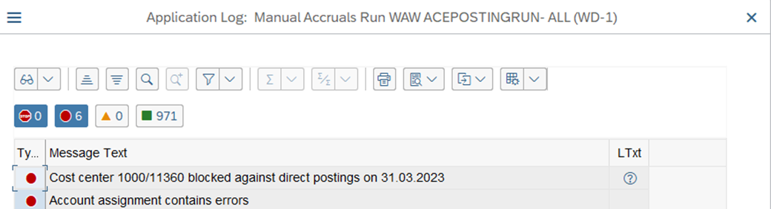
Monthly Accrual Run - Common Error
Detail of the “Errors” can be checked from the “Output Logs”. GBS/JTBC GL Team needs to check the error and work as per the resolution mentioned below.
Error | Error Description / Causes | Resolution
Account assignment contains errors | Monthly Accrual Run is executed based on master data provided by Market. Sometimes we can face an issue connected with Account Assignment, such as blocked Cost Center or blocked Profit Center | GBS/JTBC GL Team needs to check to which market the Account Assignment which is causing issue belongs to To check Cost Center master data, use T-Code KS03. To check Profit Center master data, use T-Code KE53. See details on the next slide. GBS/JTBC GL Team need to inform respective markets about the issue. The market should then initiate the request to correct the master data, e.g. unblock a Cost Center, or change Cost Center in Accrual Object, before the next Accrual run.

Slide 10
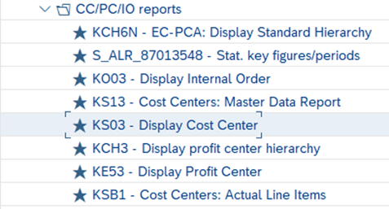
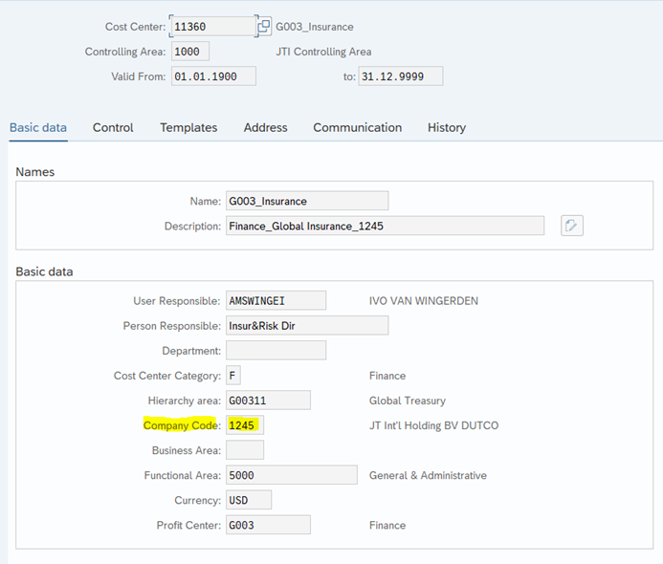
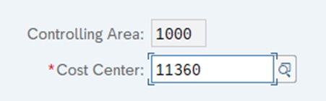
Monthly Accrual Run - Check in case of error
1. T-Code: KS03
2. Enter the “Controlling Area’ & “Cost Center” from the Error Log.
3. Identity the “Company Code” to which Controlling Object (Cost Center) causing an error belongs to. Ask the Market Team to correct the Master Data.

